Slide 1
0
1
2
3
4
5
6
7
8
9
10-04
10-28
11-21
12-15
01-08
02-01
02-25
03-21
04-14
05-08
06-01

Slide 2
… | … | … | … | … | … | … | …
… | 1.2 | 2.5 | 5.6 | 7.8 |  | 6.7 | …
… |  | 5.3 | 3.5 | 0.3 | 5.3 |  | …
… |  | 3.4 |  |  | 8.5 | 7.8 | …
… | 1.4 | 9.8 |  | 7.8 | 3.4 | 2.3 | …
… | 7.9 | 8.6 | 6.3 | 7.3 | 3.5 |  | …
… |  | 1.2 | 2.3 | 1.7 | 4.5 | 5.2 | …
… | … | … | … | … | … | … | …
… | … | … | … | … | … | … | …
… | 1.2 | 2.5 | 5.6 | 7.8 |  | 6.7 | …
… |  | 5.3 | 3.5 | 0.3 | 5.3 |  | …
… |  | 3.4 | 5.4 |  | 8.5 | 7.8 | …
… | 1.4 | 9.8 |  | 7.8 | 3.4 | 2.3 | …
… | 7.9 | 8.6 | 6.3 | 7.3 | 3.5 |  | …
… |  | 1.2 | 2.3 | 1.7 | 4.5 | 5.2 | …
… | … | … | … | … | … | … | …

Slide 3
……
……
t₀
t_{n-1}
t_{n}
t_{n+1}
t₉

Slide 5
Satellite Image
(n, h, w, c, t)
reshape
Pixels Input
(n*h*w, c*t)
Tree 1
Tree 2
Tree 1200
(…)
Prediction 1: IS wheat
Prediction 2: NOT wheat
(…)
Prediction 1200: NOT wheat
Average
Final Prediction:
NOT wheat

Slide 6
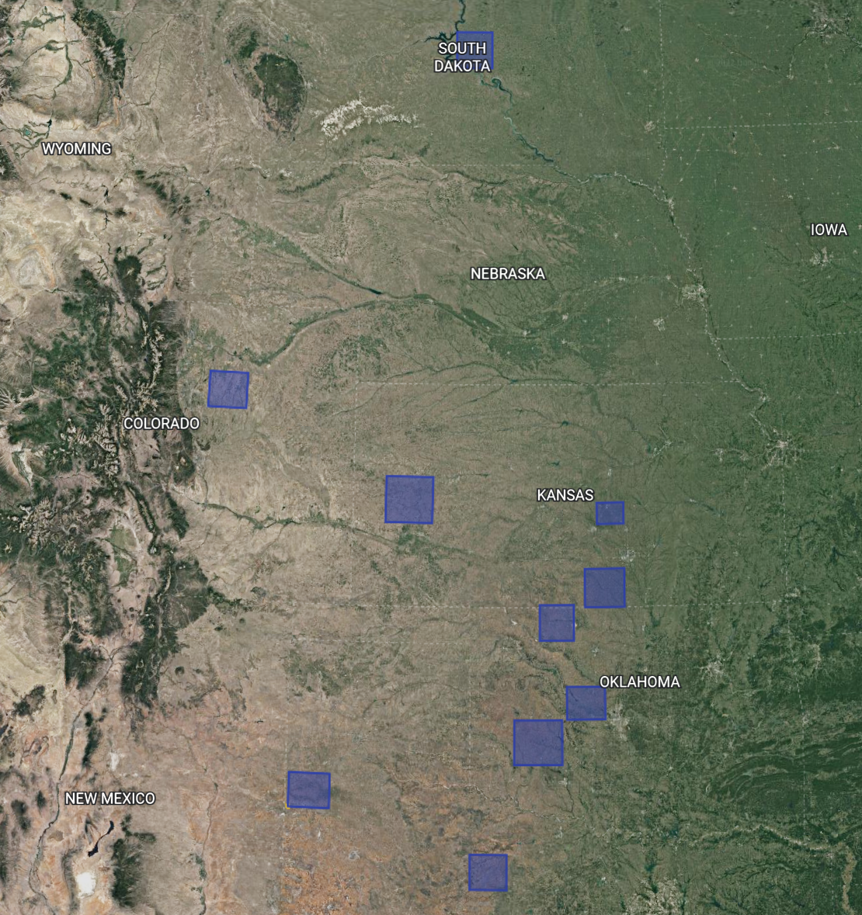
6
4
5
0
1
9
7
8
2
3

Slide 7
conv 3×3, BN, ReLU
concatenate
max pool 2×2
transposed-conv 3×3
conv 1×1
grouped convolution
concatenate
max pool 2×2
transposed-conv 3×3
conv 1×1

Slide 8
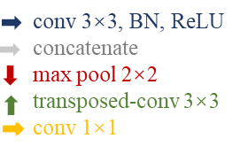
80
256
256
512
256
256
1
Input
satellite
images
Wheat
segmentation
map
256×256
256×256
256×256
256×256
256×256
256×256
512
512
1024
512
128²
128²
128²
128²
128²
128²
1024
1024
2048
1024
64²
64²
64²
64²
64²
64²
2048
2048
2048
2048
32²
32²
32²
32²
32²
32²
16²
4096

Slide 9
Predicted Label
Not Wheat
Is Wheat
Not Wheat
True Negative(TN)
False Positive(FP)
True Label
Is Wheat
False Negative(FN)
True Positive(TP)

Slide 10
x
Down Sample Module
grouped convolution
res-connect
max pool 2×2
x
2x
(2y)²
x/10
x/5
2x
2x
…
…
t₁
t₁
t₂
t₀
t₂
t₉
t₀
t₉
y²
Grouped Convolution
Res-connect

Slide 11
Up Sample Module
x
x
x
x
2x
2x
(2y)²
(2y)²
grouped convolution
res-connect
transposed conv 3×3
concatenate
2x
Res-connect

Slide 12
Input
x1
x2
x3
grouped convolution
concatenate
max pool 2×2
transposed-conv 3×3
conv 1×1
res-connect

Slide 13
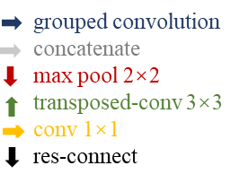
80
140
140
280
140
140
1
Input
satellite
images
Wheat
segmentation
map
BiConvLSTM
256×256
256×256
256×256
256×256
256×256
256×256
280
280
560
280
BiConvLSTM
128²
128²
128²
128²
128²
128²
560
560
1120
560
BiConvLSTM
64²
64²
64²
64²
64²
64²
1120
1120
BiConvLSTM
1120
1120
32²
32²
32²
32²
32²
32²
16²
2240

